Slide 1
Migrations made easy using fluentmigrator
Create organized migrations files in your code and ready for devops
💻@codecampos

Slide 2
$ whoami
.NET Developer for 8 years
Mostly on mobile development
Xamarin developer since 2015
Xamarin certified since 2017
Currently working as a consultant for us based company
Usually… you will find me coding under a palm tree at the beach 🏖🌴🥥

Slide 3


Live scenario
You are about to start a new project / idea / startup
You define:
Your architecture
Your language
Your database
you will buy a new computer too
(the computer may be an excuse)
Probably you will buy a car when the project successes.

Slide 4

Live scenario
You have everything setup
You create your database
Your project is up and running and …
Done
Seriously … you are done

Slide 5

Live scenario
But …
Your client needs a blog api
Blogpost table, comments table, likes, etc.
Imagine what will come in the future

Slide 6

What is a migration?
No… not this kind of migration

Slide 7
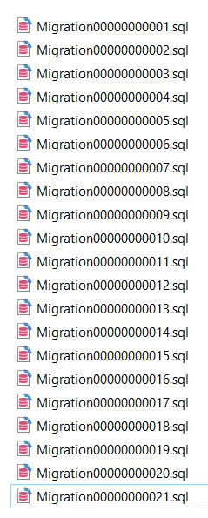
Database migrations
A process to escalate or rollback your schema database
Popular Object-Relational Mapping (ORM) frameworks, has this capability (entity framework, Django, rails, etc.)
GRANULAR CHANGES AS INDIVIDUAL SCRIPTS TO HAVE AN HISTORY OF CHANGES REGARDING YOUR DATABASE.
… or you can create your SQL Scripts

Slide 8

Problems running your sql scripts
Difficult to understand
Not object-based scripts
Not always automated
Engine dependency
… besides that, everything should be fine.

Slide 9
Fluentmigrator
Open source library that allows you create migration scripts on .net
Pros
Open source.
Integrated on dotnet cli.
Cross platform.
One library for Multiple database are allowed: SQL Server, SQLITE, oracle, MySQL (exceptions may applied).
Cons
This is not an ORM…
You have to run migrations “manually”.
Some limitations between database engines.

Slide 10
Requirements
.NET Core 2.0+ (make sure you can run dotnet command from your console).
You can use Visual Studio 2019, Visual Studio for Mac or Visual Studio Code as IDE
Create a .NET standard 2.0 library to store
Add FluentMigrator, FluentMigrator.Runner
From your console: Install FluentMigrator CLI

Slide 11


Let’s run some code …

Slide 12
Next steps
Run your migrations based on an specific environment: Development, Staging, Testing, Production.
Run your migrations using CI/CD services: Azure DevOps, Amazon, Digital Ocean, etc.
Run your migrations when your app is starting.
Applied different migrations depending of the database engine:
Run Migration 201910251200 IfDatabase(‘sqlserver’)

Slide 13
Q/A

Slide 14

Thank you
Social Media:💻@codercampos
Contact: me@carloscampos.dev
This talk: https://github.com/codercampos/fluentmigrator-talk-dotnet
FluentMigrator: https://fluentmigrator.github.io/

